Slide 1
Repeat Photography
Quantify the glacial erosion per year by comparing repeat photography photos
Jack Duggan, James Hughes and Ciaran O'Connor

Slide 2
The Plan
1. Find images
2. convert to colour space
3. Blur, sharpen, etc
4. Bitwise images
5. Quantify the difference.

Slide 3
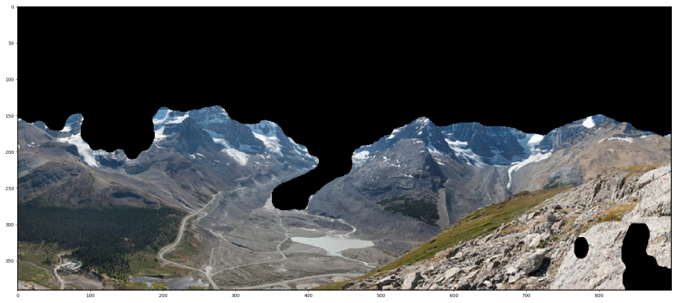
First, get all the areas that are grey in the new photo.
This will be all the areas of bare mountain in the image, not including the sky, snow or glacier.

Slide 4
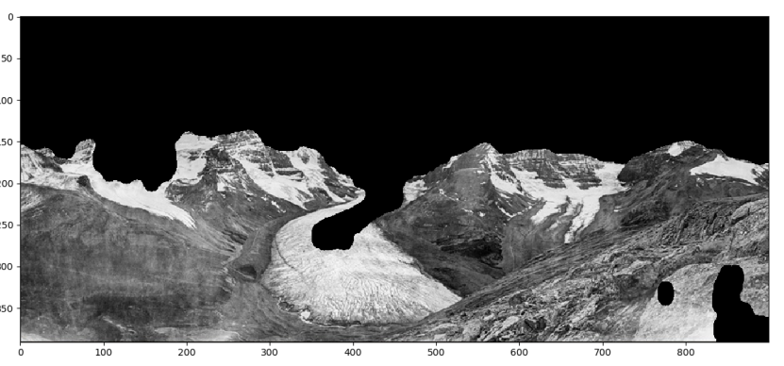
Now we need to use the mask we just created and extract the same region of interest but on the old image.
This will give us the area of the old image where now, there is mountain.

Slide 5
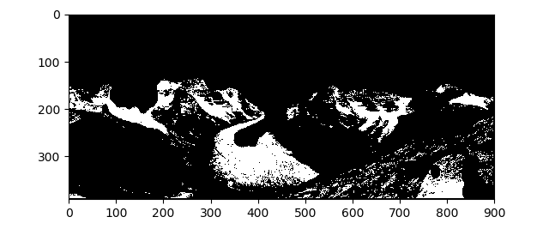
Now we need to separate the white elements of this image.
This will give us the areas of white from the old image where now, there is nothing.
We do this by specifying the range of white colours we wish to separate by and create a mask that we then use on the image above.

Slide 6
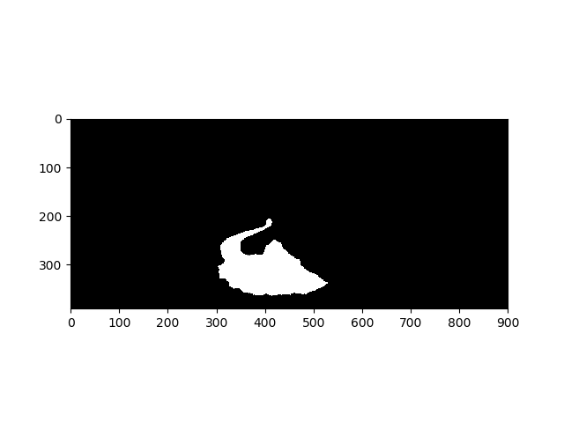
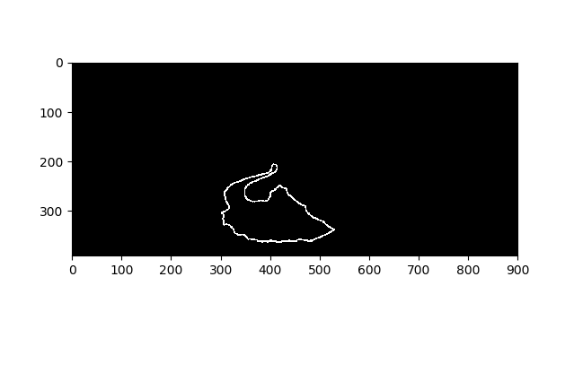
We get the contours of this mask to extract each individual shape, iterate through them all and mark the one with the largest area.
We perform a morph close on this mask with a large ellipse, and then open it after, this gives us a nice clean mask of just our glacier.
We also create a mask of the outline of this contour which we will use for smoothing later.

Slide 7
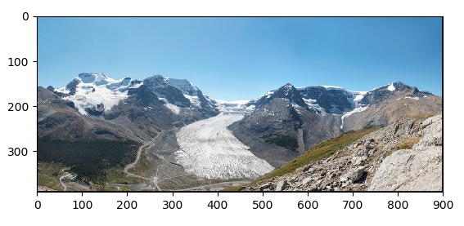
We can now combine the images using the mask as the area of interest.
This will give us a view that appears as if the glacier had never eroded away at all.
We also use the contour border mask we create earlier to help blend the two images together using the inpaint function.

Slide 8
Feature finding

Slide 9
Masking & morphology
Mask below 140
Open and close
Find contours
Mask contours

Slide 10
Overlaying Images
Show glacier
Adds white to mask
Draw on old image

Slide 11
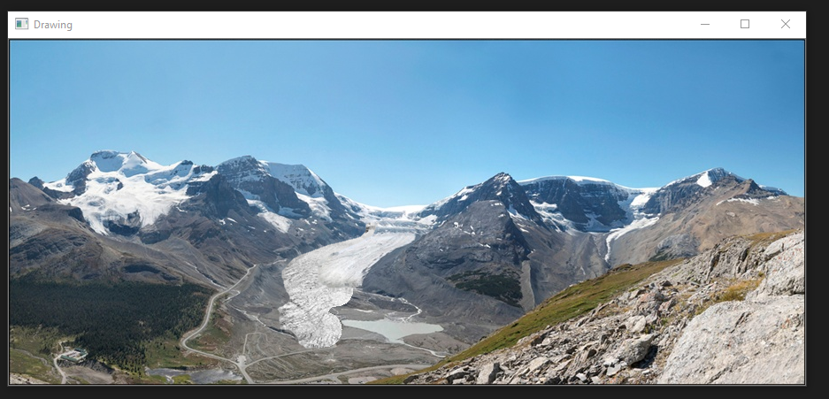
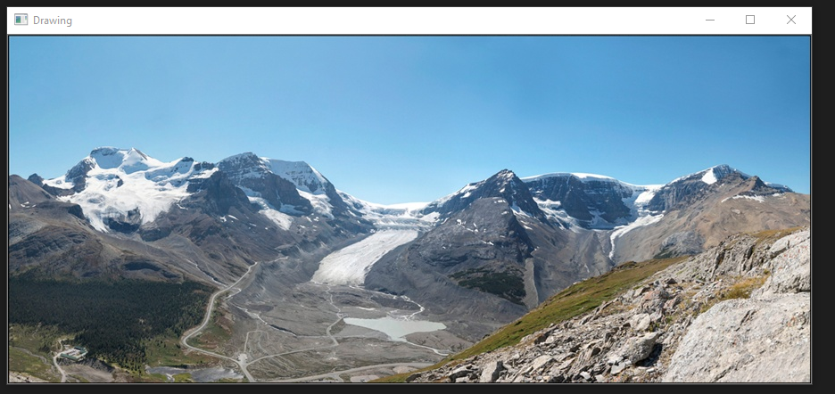
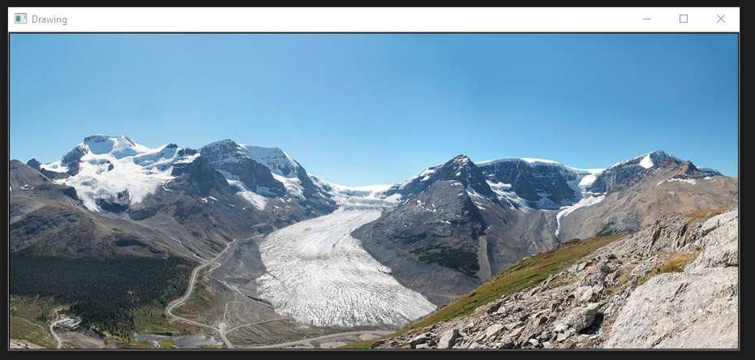
Outcome
During
Before
After

